Slide 1
December 8, 2022
Quarterly Meeting

Slide 2
Welcome & Introductions
Thank you for joining us!
Please introduce yourself and tell the group what organization you are representing.

Slide 3
Featured Presentation
Wendy D. Darwell
President and CEO
Suburban Hospital Alliance of New York State Nassau-Suffolk Hospital Council

Slide 4
State and Federal Update
Long Island Health Collaborative Quarterly Meeting
December 8, 2022

Slide 5
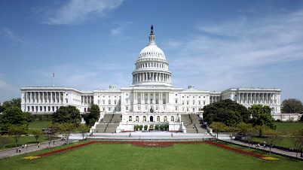
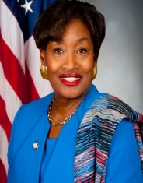
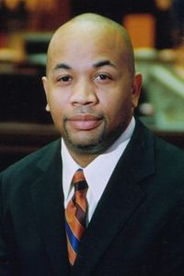
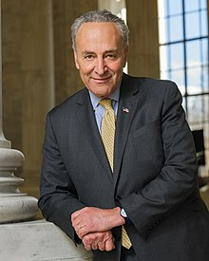
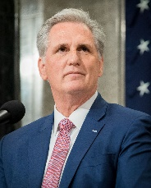
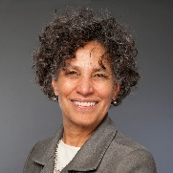
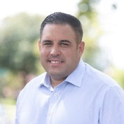
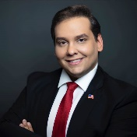
A Tale of Two Cities
Governor elected to full term, Dems hold veto-proof majorities in the Legislature
Dems hold Senate, GOP takes House, both with razor-thin majorities
New COH, DOB director coming in
Long Island instrumental to flipping House

Slide 6
Hochul on Healthcare So Far
15 months, 1 state budget and legislative session into governorship
Management of multiple health crises – COVID, Mpx, Polio, RSV
Held firm on vaccine mandate
Phased out other health precautions
More flexible on allowing healthcare providers to manage capacity, etc.
Public health initiatives
Maternal health
Master plan for aging
Immunizations
Ushered through Medicaid waiver submission

Slide 7
State Focus on Health Equity
Pre-COVID focus
Post-COVID priorities/new waiver
Language access
Cultural competence
Insurance enrollment & charity care
DSRIP focus on reducing inappropriate ED utilization, but lack of incentives for SDOH interventions
Waiver application entirely focused on equity
Defined reimbursement for SDOH interventions
Direct state investments in housing, safety net institutions, workforce
Emphasis on regional planning
$8 billion to spur transformation
$13.5 billion to advance health equity

Slide 8
Federal Public Health Investments
Largely COVID-related
American Rescue Plan investments:
Fund community health workers to boost vaccine program
Establish public health AmeriCorps
Train more primary care docs, dentists, behavioral health specialists
Health professions scholarships and loan forgiveness
Support for state/local health departments
988 hotline
Seeking input on measuring health equity
Unclear if investments can be sustained post-COVID emergency given changes in Congress

Slide 9
Persistent COVID and winter surge
Financial shortfalls
Soaring costs
Workforce shortages
Health system stress level: HIGH

Slide 10
What Comes Next?
COVID-19 demonstrated the consequences of inequity …
Inadequate access to healthcare
Inadequate access to childcare
Lack of paid sick leave
Link between socioeconomic status and health risks
Fragility of our supply chain
… but also the significant gaps in our public health infrastructure
How can we align our advocacy goals to advance health equity and strengthen the healthcare system for all? Where would you invest?

Slide 11
Thank You
Wendy Darwell, President and CEO

Slide 12
Social Media Campaigns
SHANYS Flu Vaccination Campaign
NSHC “Now’s the Time” Kids COVID Vaccination Campaign
Both available for your use
Co-branding opportunity

Slide 13
CHNA Check-In
The state CHNA deadline is December 31, 2022
LIHC report templates available for each county
2 regional priorities agreed upon by consensus
Status check-in– questions, comments, concerns?

Slide 14
Moving Forward
Core Clusters
Should we bring them back?
Cluster focus possibilities:
Existing data
Food security
Housing
?

Slide 15
Moving Forward
Island-Wide Interventions
Awareness campaigns
Live Better
Currently resurrecting
Aligns with our priority area, Prevent Chronic Diseases
New Campaign
To align with Promote Well-Being and Prevent Mental and Substance Use Disorders?
Other ideas?

Slide 16
Moving Forward
Streamlining the LIHC Website
An ongoing effort
Current website contract ends in 2023
Stay tuned

Slide 17
Ongoing Engagement
Collaborative Communications
Bi-weekly email newsletter to 400+ contacts
Submit your free events, resources, jobs, and more to boliveri@nshc.org
Subscribe to Collaborative Communications

Slide 18
Ongoing Engagement
Talk with a Doc & Walk with a Doc
Opportunity to partner
LIHC handles coordination, just asks for your efforts to co-promote

Slide 19
2023 Meetings
Quarterly meetings to continue, registration links to come on LIHC website
Thursday, March 30, 2023 at 9:30 AM
Thursday, June 29, 2023 at 9:30 AM
Thursday, September 28, 2023 at 9:30 AM
Thursday, December 7, 2023 at 9:30 AM
Next LIHC meeting: Thursday, March 30, 2023, 9:30-11:30 AM

Slide 20
Discussion

Slide 21
Adjournment
Thank you!
www.lihealthcollab.org
(631) 963-4167 lihc@nshc.org

